Slide 1
MIC3 Program Overview
Mark Conroy
MIC3 Program Manager

Slide 2
Agenda
Welcome and Introduction
MIC3 Program Overview
Requirements for Membership
Deployment Checklist
MiC3 Responsibilities
Stakeholders Goals and Leadership
Michigan State Police
Ongoing Activities
MiC3 Membership
MI Cybersecurity External Engagements
Michigan Secure
Resource Links
Questions and discussion

Slide 3
What is the Michigan Cyber Civilian Corp (MIC3)
Michigan Cyber Civilian Corps (MiC3) is a group of trained, civilian technical experts who individually volunteer to provide rapid response assistance to the State of Michigan in the event of a critical cyber incident. The mission of MiC3 is to provide mutual aid to all levels of government, education, and business organizations in the State of Michigan in the even of critical cyber incident. The MiC3 system is comprised of a public facing site which allows users to register through MiLogin with the Michigan Cyber Civilian Corps and take a series of tests to determine their eligibility. www.micybercorps.org This site also allows applicants to upload their volunteer agreement, employer support form, resume and background check (CJIS-008) forms to onboard as a MiC3 member. Current members are able to manage their documents and update their address, employer, phone number, and documentation as needed once admitted. It also has an intranet-only site used by administrators to view/edit registrant demographic information, test results, applicant and member documentation, and track member event participation.

Slide 4
Requirements for Membership
Membership is open to Michigan residents who: Have at least two years of direct involvement with information security, preferably with security operations, incident response, or digital or network forensics. Possess a basic security certification. ANSI-certified/DOD 8570 compliant certifications, such as Security+, C|EH, CISSP, or GIAC certifications, are strongly preferred. Pass a series of tests to demonstrate basic knowledge of networking and security concepts, as well as basic IR and forensics skills. Commit to up to 10 days/year for training and exercises. Provide evidence of employer support. Pass a background screening / fingerprint and sign a confidential disclosure agreement.

Slide 5
​​
​Michigan Cyber Civilian Corps – Certification Requirements
​​ CISSP - Certified information systems security professional GCIH - Certified Incident Handler Certification GMON - Continuous Monitoring GNFA - Network Forensic Analyst CCNA-Secur - Cisco Certified Network Associate Security C\EH - Certified Ethical Hacker OSCP - Penetration Testing GCED - Certified Enterprise Defender (GCED) GCIA - Certified Intrusion Analyst Certification GCFA - Certified Forensic Analyst GCDA - Certified Detection Analyst GREM - Reverse Engineering Malware

Slide 6
​​
​Michigan Cyber Civilian Corps – Deployment Checklist
​​ PURPOSE Public Act 132 titled the “Cyber Civilian Corps Act” of 2017 outlines the deployment framework and standards for MiC3 volunteers to respond to a cyber incident. The following checklist must be met before MiC3 members are authorized to report to a cyber incident. Deployment Checklist MiC3 members are only authorized to assist with a cyber incident if the following documentation has been processed by DTMB: ___ Member has successfully passed 4 of 5 assessment tests through the MiC3 application, or equivalent. ___ Member has completed and cleared Michigan State Police criminal background check. ___ Member has completed and cleared FBI Criminal Records check (prints). ___ Member has a copy of their resume on file with DTMB. ___ Signed volunteer and employer agreements from member; including attestation clause. ___ A written request to the State of Michigan from client seeking MiC3 assistance. ___ A written response to client acknowledging request and offering of assistance from DTMB CSO. ___ A signed acceptance to deploy for MiC3 member(s) for every 7 days deployed.

Slide 7
MIC3 Responsibilities
Member Responsibilities Ensure all required documents including certifications are uploaded and current. When changing employers update their profile and upload a new employer support form. Attend training and scheduled meetings as available. If deployed to a facility, provide identification prior to entering the facility. Comply with all facility security procedures. Record arrival and departure times and activity while at facility. MiC3 Responsibilities Ensure the responding MIC3 volunteer has updated all required certification documents and passed background checks. Provide volunteer with required hardware and software. Provide clear roles and responsibilities when deployed to a site. Assist with training needs. Provide periodic MIC3 program updates. Respond to all volunteer questions and requests.

Slide 8
Stakeholders and Goals
Department of Technology, Management, and Budget DTMB is the organizational owner of the MiC3 program, managing and operating the program consistent with statute and policy. As such, DTMB leaders hold a number of roles related to the program: State of Michigan Chief Information Officer (CIO) – As head of the State’s IT and cybersecurity operations, the CIO is ultimately responsible for the program’s success. However, operation of the program is delegated to the State of Michigan Chief Security Officer and Michigan Cyber Security (MCS). State of Michigan Chief Security Officer (CSO) – The CSO, as the leader of DTMB Cybersecurity and Infrastructure Protection’s MCS, is the program sponsor and oversees it on behalf of the CIO. The CSO authorizes the deployment of MiC3 resources as well as the extension and conclusion of deployments. MiC3 Program Owner – Reporting to the CSO, the Program Owner is the primary executive that oversees the MiC3 program. Typically, the Deputy Chief Security Officer or Chief of Staff to the CSO, the Program Owner supervises deployments and helps set strategic direction for the program, including goals and budgets

Slide 9
Stakeholders - Leadership
MiC3 Program Manager – The day-to-day manager of the MiC3, the Program Manager is responsible for overall member engagement and communication from point of recruitment through the span of the members active membership duration. He or she also serves as the primary point of contact for members, the MSP’s Michigan Cyber Command Center (MC3), the MCS Cyber Partners program, and MCS leadership during deployments. The MiC3 Program Manager is also responsible for completion of the after-action report, including lessons learned, and, in coordination with the MiC3 Program Owner, creates the yearly goals for the overall program, member engagement, member recruitment, and training plan for each fiscal year. He or she also engages with the cyber community for outreach, networking, and overall program awareness to potential clients. MiC3 Program Coordinator – Is responsible for the facilitation of onboarding applicants for MiC3 membership, the management of program documentation and member files, and tracking compliance with established policies. This includes notifying the Program Owner and Program Manager of member eligibility status, keeping the MiC3 Playbook up to date, and capturing action items for MiC3 Advisory Board meetings.

Slide 10

Michigan State Police – MC3
1-877-MI-Cyber
MC3@michigan.gov
1-877-642-9237
The Michigan Cyber Command Center (MC3) investigates the criminal aspect of network intrusions for cyber incidents involving Michigan businesses and public entities, including those incidents related to ransomware, phishing, business email compromises (BEC), and malicious insiders. MC3 also assists other law enforcement agencies with forensic services for similar investigations. In addition, the MC3 provides cybersecurity education and shares cybersecurity information with the public.

Slide 11
Michigan State Police
Michigan State Police MSP is a vital partner for the MiC3 and an integral part of responding to cybersecurity incidents occurring in Michigan’s digital ecosystem. Michigan Cyber Command Center (MC3) The MC3 receives initial reports of potential cybersecurity incidents impacting covered entities, referring organizations to the MiC3 if the victim feels they need assistance responding to and recovering from cybersecurity events. The MC3 also determines if a criminal investigation is required and is kept abreast of any developments during a deployment. Background Check Coordinator Every member of the MiC3 requires a completed background check before he or she can join the organization. The Background Check Coordinator manages and facilitates the background check clearance process on behalf of MiC3 to ensure proper clearance of MiC3 members.

Slide 12
Ongoing Activities
Review and update policies, procedures and program charter. Coordinate with MC3 to develop roles and responsibilities checklist when deployed to a site. Develop a list of hardware and software requirements when deployed to a client site. Research training opportunities relating to members needs. Attend presentation opportunities to educate the public and private sector on available cyber resources. Focus on retaining existing members and recruitment opportunities.

Slide 13
MiC3 Membership
Officially Included in State Cyber Response Plan
Members Complete Regular Training to maintain skills
Professional Networking
Support for other Civic Efforts
Want to Serve? Join the MIC3
MiC3 | MiC3 (state.mi.us)

Slide 14

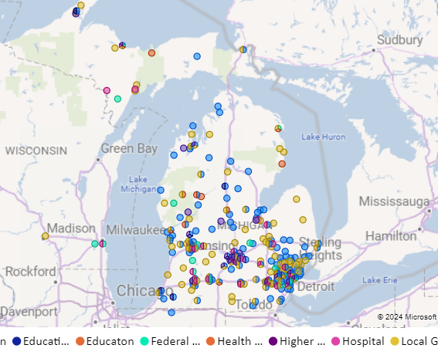
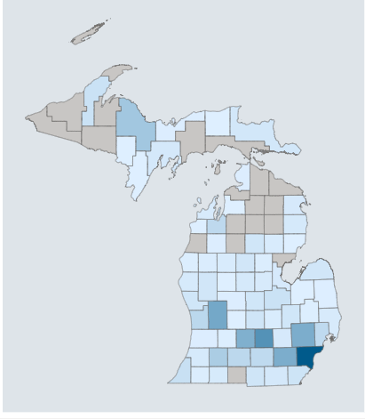
Michigan Cybersecurity External Engagements Programs
Cyber Partners Meeting
Michigan Cyber Civilian Corps (MiC3)
Michigan Cyber Sumit

Slide 15
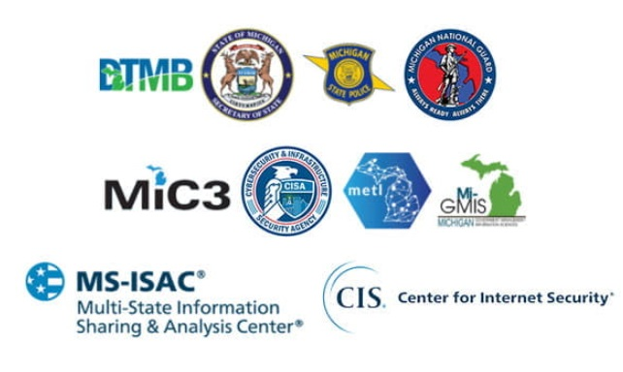
Michigan Cybersecurity External Engagements Programs
Cyber Emergency | Incident – 1-877-MI-CYBER (1-877-642-9237)
MC3@michigan.gov
Michigan Cybersecurity Partnerships Focuses on building connections between local and municipal governments, schools and other organizations to improve the state of cybersecurity in Michigan.
Michigan Cyber Civilian Corps (MiC3)
is a group of trained, civilian technical experts who individually volunteer to provide rapid response assistance to cyber incidents in the State of Michigan.
The Michigan Cyber Summit
An annual event organized by the State of Michigan that provides a forum for leaders, professionals, and others to share cyber security best practices.

Slide 16
Michigan Cybersecurity External Engagements Programs
Cyber Emergency | Incident – 1-877-MI-CYBER (1-877-642-9237)
MC3@michigan.gov
DTMB-CIP-SLCGP@michigan.gov
State Local Cybersecurity Grant Program
www.michigan.gov/cybergrants | Sign up for Cyber Grant Updates

Slide 17

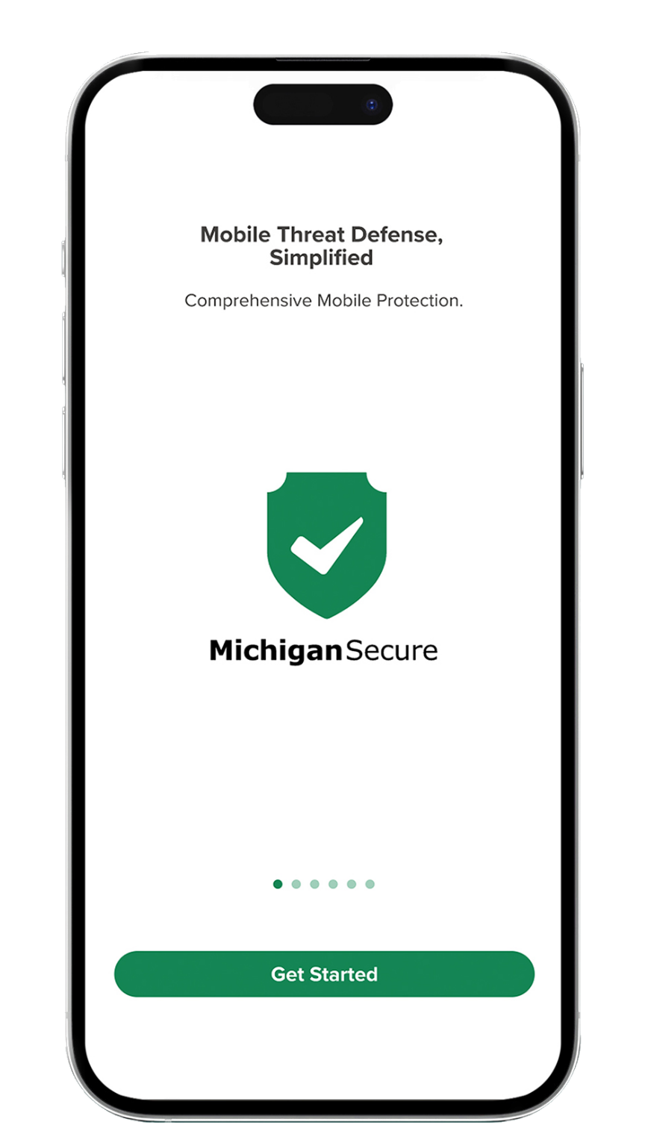
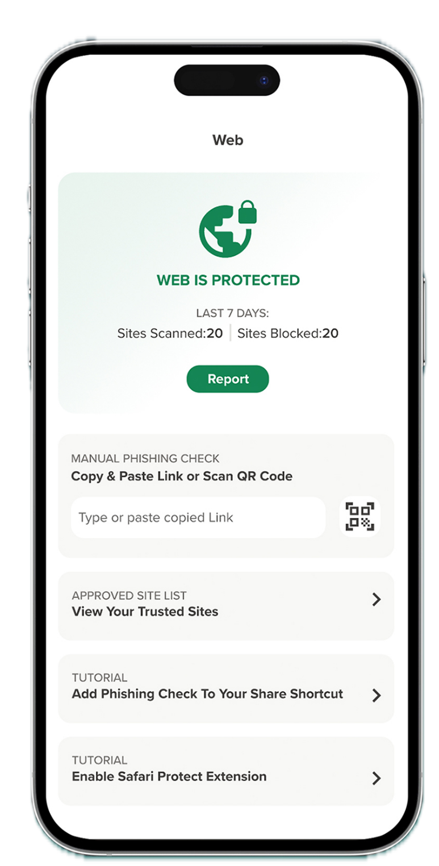



Michigan Secure is a free mobile protection app for Michigan residents.
Michigan Secure has many features, including:
App risk lookup and privacy summary
Phishing protection
Risky QR code detection
Threat zone detection
Unsecure Wi-Fi alerts
No user data is collected.
Learn more at Michigan.gov/MichiganSecureApp.

Slide 18
Resource Links & Information
State of Michigan
Email questions or general grant information – DTMB-CIP-SLCGP@michigan.gov
Michigan Secure App - DTMB - Michigan Secure - Slide Included
Michigan Cyber Command Center- MC3 – MC3@michigan.gov
  1-877-MI-CYBER | 1-877-642-9237
Michigan Cyber Civilian Corps – Michigan.gov/cybersecurity
Sign Up for Automatic Updates & Bulletins Grant Progress, Information Updates & Funding Opportunities -
Sign UP For SLCGP Grant Updates and Funding Opportunities
MS-ISAC | FEMA Resource(s) Links
CISA Cybergrants Website: https://www.cisa.gov/cybergrants-faq
SLCGP Road Map – Partner supporting required elements offerings : SLCGP (cisecurity.org)
SLCGP FY2023 NOFO - The Department of Homeland Security Notice of Funding Opportunity Fiscal Year 2023 State and Local Cybersecurity Grant Program | FEMA.gov
SLCGP CISA Website : State and Local Cybersecurity Grant Program | CISA
FEMA SLCGP Website: State and Local Cybersecurity Grant Program | FEMA.gov
Michigan.gov/cybergrants

Slide 19
Resource Links & Information
For cyber tips and crimes, contact the Michigan State Police.
For Internet-related complaints to federal, state, local, or international law enforcement, contact the Federal Bureau of Investigation investigates.
For computer/internet crimes against children, contact the Michigan Attorney General.
For internet services, online shopping, computers, and mobile devices, contact the Federal Trade Commission.

Slide 20
Questions / Discussion
Mark Conroy
MIC3 Program Coordinator
State of Michigan, Dept. of Technology, Management & Budget
Cybersecurity and Infrastructure Protection
Michigan State Police Headquarters
7150 Harris Dr. Dimondale, MI. conroym1@michigan.gov
(781) 985-7052

