Slide 1

Cloud Vendor Security
Infosec Assessments & Reports

Slide 2
April 1 - News Flash! Conficker…
A master computer was reportedly scheduled to gain control of millions of infected zombie machines on April 1, 2009
Conficker malware uses flaws in Windows OS software and dictionary attacks on administrator passwords to propagate while forming a botnet, and has been unusually difficult to counter because of its combined use of many advanced malware techniques
Anti-worm researchers banded together in a group called the Conficker Cabal. Members searched for the malicious software program's author and for ways to do damage control if he or she couldn’t be stopped. They were motivated in part by a $250,000 bounty from Microsoft.

Slide 3
Introduction
Cloud Vendor Security –
- Are company “Crown Jewels” in the cloud?
- What evidence do you have that company data in the cloud is secure?
Abstract: Lloyd Guyot will lead a collaborative discussion based on his experience implementing and leading a Cloud Vendor Security Assessment service for a global, Fortune 100 company. Topics to be discussed include the processes, procedures and tools used in assessing a Cloud Vendor security posture.
Speaker: Lloyd Guyot, CISSP, CISM resides in West Michigan and is a Lead Security Analyst for Johnson Controls, a global Fortune 100 company headquartered in Milwaukee, Wisconsin. Lloyd has over 15 years’ experience in the Information Security field and is an Adjunct at Davenport University and serves on the FBI InfraGard / U.S. Homeland Security – West Michigan Board of Directors.

Slide 4
Agenda - It’s all about the Data!
Who’s Accountable for What?
Where’s the Data?
The Cloud Vendor Security Assessment Service
    The SLO – Service Level Objective
    The Service Web Portal
    The Request Form
    Where’s the Beef? …the Vendor Evidence
    Calculating the Vendor Risk Score
    Writing the Cloud Vendor Security Report
    The Annual Cloud Vendor Re-Assessment
    The Cloud Vendor Service Team Dashboard
    The Cloud Vendor Service Metrics
A Few Good Resources…

Slide 5
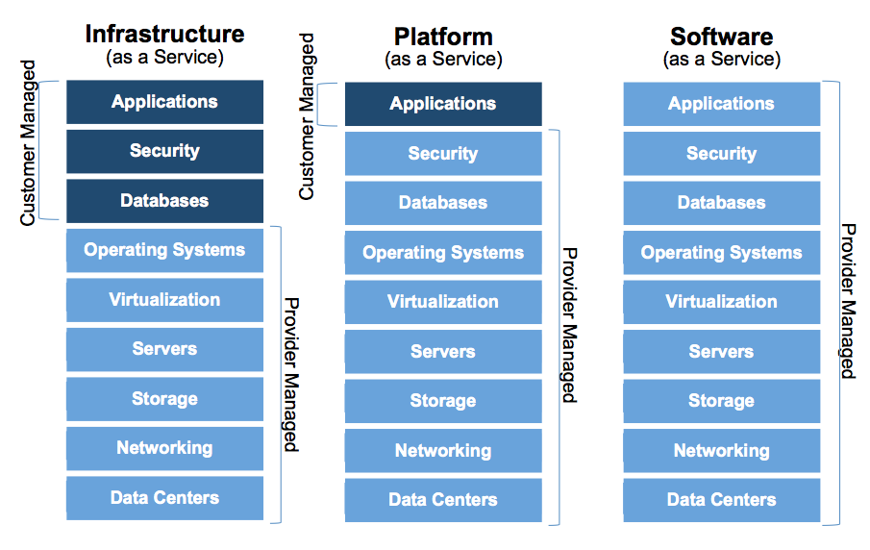
Who’s Accountable for What?

Slide 6
#1 - Identify and Follow the Data…
Public > Internal > Confidential > Restricted
Identify
Engineering, Financial, Business, HR, legal, and regulatory data (HIPAA, PCI, FISMA, DFARS, ITAR, EAR)
PII - Personally Identifiable Information (social security numbers, credit card information, personal health data)
IP - Intellectual Property (patents, trademarks, design plans - Engineering drawings)
Follow
Once this information has been identified, a flow analysis needs to be conducted to identify all systems and devices the data either resides on or flows through.
Data Flow Diagram - Transport > Storage > Process

Slide 7
Cloud Vendor Security Assessment Service
Service Description
Review Vendor security controls related to Vendor policy, process, and people for protecting the confidentiality, integrity and availability of company information
    Note: The assessment does not include a security review of the project or system architecture, application, infrastructure design or related technologies.
Service Level Objectives - SLO
3 business days to respond to request
7 business days to provide a report & position statement after all requested Vendor documentation has been provided

Slide 8
The Cloud Vendor Service Web Portal
SharePoint…
  Customer View
    Service Description
    Benefits
    Process Map
    Inputs / Outputs
    Resources
        Requested Vendor Documents
        How to Submit a Request
        Checklist Prior to Submit
        FAQ’s
  Security Team View
    Vendor Support Documents
    Team Member Data Entry
    Vendor Dashboard

Slide 9
The Vendor Service Request Form
Requester Name / Title, Department, BU
Procurement Staff Contact Info
Project Name and Business Scope Info
Vendor Name and Service(s) Provided
Vendor Sub-Service Providers
IaaS / PaaS / SaaS
Data Classification – Public > Internal > Confidential > Restricted
Example Data Types Transported / Stored / Processed
Cont.…

Slide 10
The Vendor Service Request Form Cont.…
Cloud Vendor Documentation Requested…
Data Flow doc including security controls and all end points
Third-party evidence of a Security Program
Eg. ISO 27001:27005
Third-party evidence of Infosec Controls and their effective operation Eg. SSAE-16 SOC 2 Type 2
Third-Party System / application Penetration test report
Third-Party System / application Vulnerability scan report
Business Continuity and Disaster Recovery Questionnaire
Privacy Questionnaire

Slide 11
Vendor Evidence of InfoSec Controls
SSAE-16 (U.S.) / CSAE 3416 (Canada) / ISAE 3402 (International)
    Note: We request the above security reports to be SOC 2, Type 2 documents which include tests confirming the effectiveness of the Vendor service security controls
ISO/IEC 27001:27013 - certification that the Vendor service has a security program
Application Penetration Test and Vulnerability Scan Reports
In an Exception…
CSA STAR - CCM / Cloud Security Alliance - Cloud Controls Matrix
Attestation of cloud service provider security practices
Other - Independent security / privacy assessment from a known trusted security firm

Slide 12
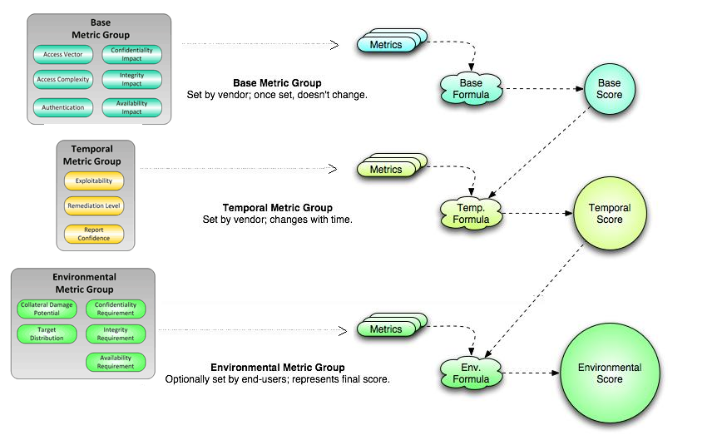
The Cloud Vendor Risk Score
NIST CVSS Risk Calculator - Common Vulnerability Scoring System
The National Vulnerability Database assigns risk rankings according to CVSS Base risk scores –
Low: 0.0 to 3.9
Medium: 4.0 to 6.9
High: 7.0 to 10.0

Slide 13
NIST CVSS Risk Calculator Cont.…
Base Metrics - characteristics that are constant over time and between different environments
        Exploitability: Access Vector / Access Complexity / Authentication
        Impact: Confidentiality / Integrity / Availability
Temporal Metrics characteristics that change over time.
        Exploitability: Unproven / Proof of Concept / Functional / High
        Remediation Level: Official Fix / Temp Fix / Workaround / Unavailable
        Report Confidence: Unconfirmed / Uncorroborated / Confirmed
Environmental Metrics - tied to an implementation in a specific users environment.
        Collateral Damage Potential: None / Low / Medium / High
        Targeted Distribution: None / Low / Medium / High
        Impact: Confidentiality / Integrity / Availability

Slide 14
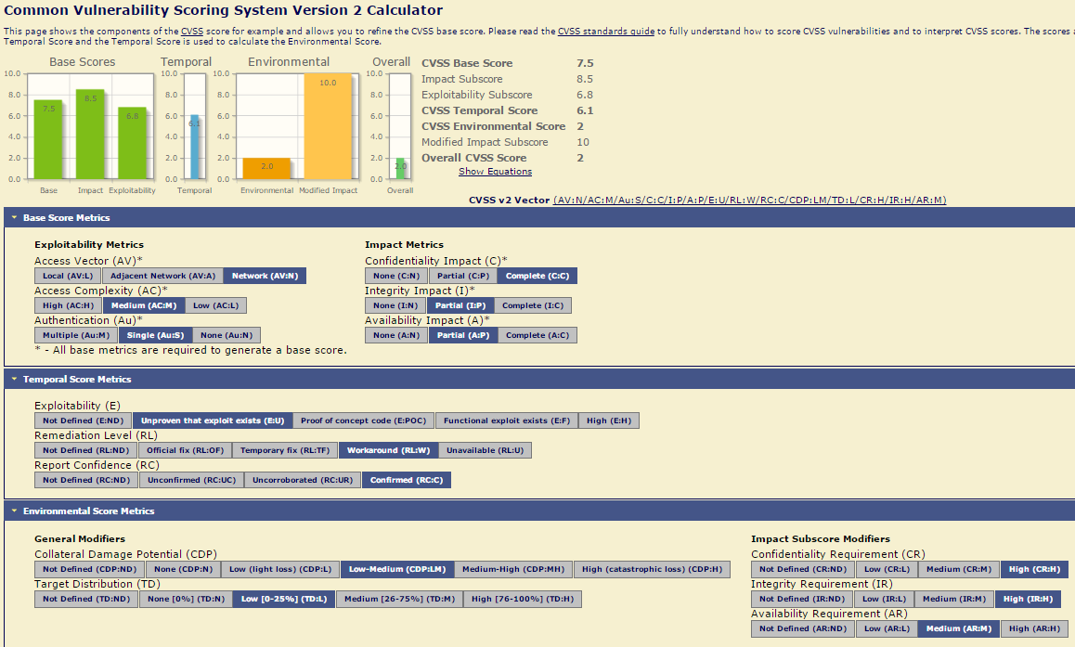

Slide 15
The Cloud Vendor Security Report
Cloud Vendor Name and Scope of Service
Names of Vendor Sub-Service Providers
(all providers that transport, store or process company data)
Data Classification and Example Data Types
Vendor security assessment position statement
        “Acceptable” / “Not Acceptable”
        High / Medium / Low Risk Rating < Note: By default the CVSS number is not presented
Scope of Review
General Comments & Action Items
Vendor defined Complimentary Security Controls
Project Background
Data Flow Diagram
Vendor Background
Findings / Example issues of concern based on evidence and/or attestations provided for review

Slide 16
Annual Cloud Vendor Re-Assessments
Any changes to…
MSA / SLA?
Services Provided?
Scope of Engagement?
Data Types / Data Classification?
Changes in Cloud Vendor Infosec controls?
Remediation follow-up required?
All “Action Items” addressed and completed satisfactorily?
All current Cloud Vendor security reports been provided?
    Any issues / findings?
New > Security Team Position Statement
“Acceptable” / “Not Acceptable”
    High / Medium / Low Risk Rating

Slide 17
The Vendor Service Team Dashboard
SharePoint Database / Archive
        Vendor Name
        Data Classification
        Work Status – Cancelled, Pending > Open > Completed
        Security Assessment Manager
        Vendor Position Statement
        Vendor Status Flag
        Open / Close Dates
        Requester, BU, Department
        CVSS Risk Rating
        Evidence Provided & ISO / SOC Expiration Dates
        Remediation & Complimentary Control Requirements
        Re-Assessment - Required, In-Process, Date

Slide 18
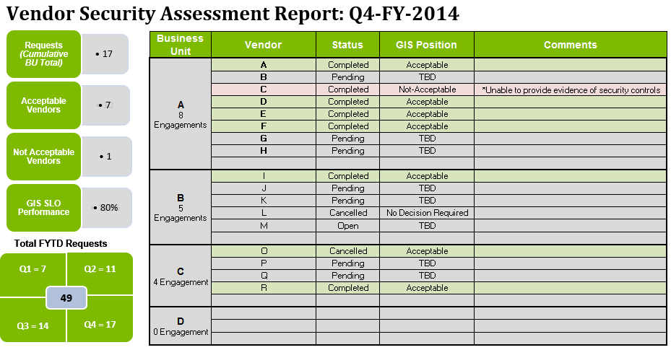
The Vendor Service Metrics
Hard to manage or improve what we don’t measure!

Slide 19
Resources
AICPA SOC Report Standards - http://www.aicpa.org/interestareas/frc/assuranceadvisoryservices/pages/sorhome.aspx
AICPA Trust Services Principles and Criteria -
http://www.aicpa.org/InterestAreas/InformationTechnology/Resources/TrustServices/Pages/Trust%20Services%20Principles%E2%80%94An%20Overview.aspx?_sm_au_=iVVQNvt0QHWWTtFq
NIST CVSS Risk Scoring - https://nvd.nist.gov/cvss.cfm
NIST CVSS Calculator - https://nvd.nist.gov/cvss.cfm?calculator&version=2
CSA / Cloud Security Alliance - https://cloudsecurityalliance.org/
CCM / Cloud Controls Matrix - https://cloudsecurityalliance.org/research/ccm/
CSA STAR / Trust & Assurance Registry - https://cloudsecurityalliance.org/star/
Shared Assessments - https://sharedassessments.org/

Slide 20

Questions?
Who Owns the Risk?
Lloyd Guyot, CISSP, CISM
Contact Info:
Email – Lloyd.Guyot@Baseline-Security.com
LinkedIn – http://www.linkedin.com/in/lguyot

